Slide 1
Enabling Bioconductor R packages for caGrid services
Session Length: approx 30 minutes
Target Audience: application developers
Trainer: self-paced
Developer contact:
Martin Morgan (mtmorgan@fhcrc.org)
Adopter contacts:
Pan Du (dupan@northwestern.edu),
Denise Scholtens (dscholtens@northwestern.edu),
Simon Lin (s-lin2@northwestern.edu)
Creation Date: August 2007

Slide 2
Session Details
Target Audience:
  Bioconductor application developers looking to enable their R packages for caGrid services or other Java applications
Prerequisites:
  Java programming knowledge
  R programming knowledge
  Web Services practical experience
  Basic UML, caGrid knowledge

Slide 3
Session Objectives
By the end of this session, you should be able to
  Describe the Bioconductor project
  Describe the caBIG initiative
  Outline the basic steps for enabling Bioconductor packages for caGrid services
  Enable the lumi Bioconductor package for caGrid services

Slide 4
Session Details:
Lesson Plan
Lesson 1: Introduction to Bioconductor / caBIG
Lesson 2: Required Steps for Grid-enabling Bioconductor packages
Lesson 3: A Use Case: Enabling the lumi Package for Grid Services

Slide 5
Lesson 1:
Introduction to Bioconductor / caBIG

Slide 6
Bioconductor
Application background
Open source statistical software
  >200 contributed packages
  R statistical programming language
High-throughput genomics and proteomics data analysis
  Gene expression array pre-processing, linear models, clustering and machine learning, expression pathways, …
  Sophisticated visualization tools
  Flexible ad hoc analyses

Slide 7
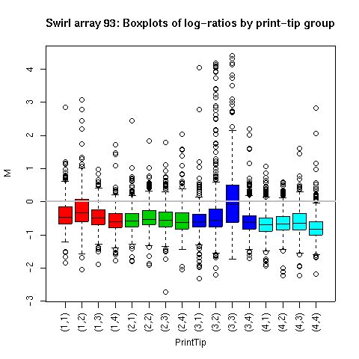
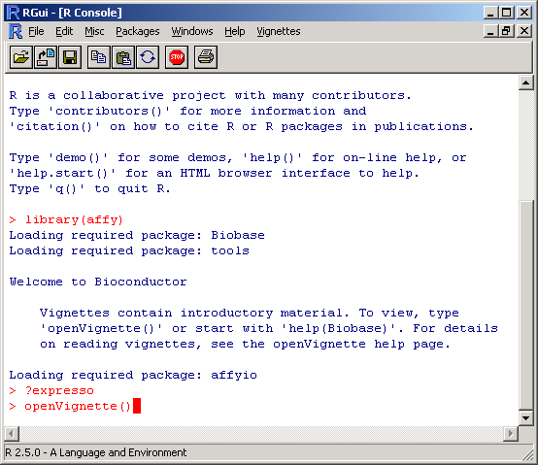
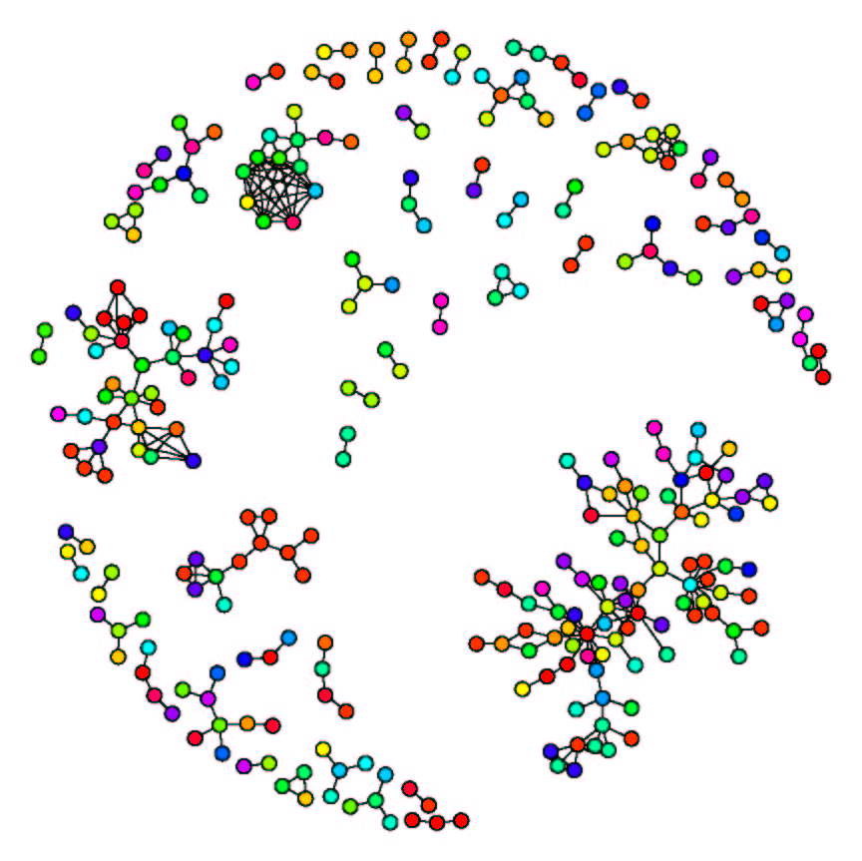
Bioconductor
Application screenshot

Slide 8
caBIGTM
cancer Biomedical Informatics Grid (caBIG)
Launched by National Cancer Institute in 2004
Open-source, open-access
Goal is to facilitate collaboration among multiple cancer research institutions by providing standards and tools for sharing:
  Data
  Applications
  Software
  Technologies
Grid services technology (specifically caGrid) provides operational support for these endeavors

Slide 9
caGrid
Grid web service specific to caBIG initiative
Acts as middleware infrastructure to support common:
  Representation of data
  Invocation of analysis tools
Facilitates integration of heterogeneous resources across organizations

Slide 10
caGrid-enabled packages
Benefits to researchers and analysts
  Tailored, standardized analysis pipelines
  Make new methods easily available
Benefits to users
  Powerful analysis methods
  Specialized computing resources
  Easy maintenance
Benefits to working groups
  Standardized analysis pipelines
  Effective resource use
  Centralized system administration

Slide 11
Scalable, flexible system architecture
Tomcat
caGrid
Bioconductor
service
Bioconductor
worker 1
activeMQ
Bioconductor
worker 2
Etc.

Slide 12
caGrid-enabled Bioconductor packages
Current analytic services (caBIG gold compatible)
  Mass spec. peak identification – caPROcess
  DNA copy number variation – caDNAcopy
  Microarray preprocessing – caAffy

Slide 13
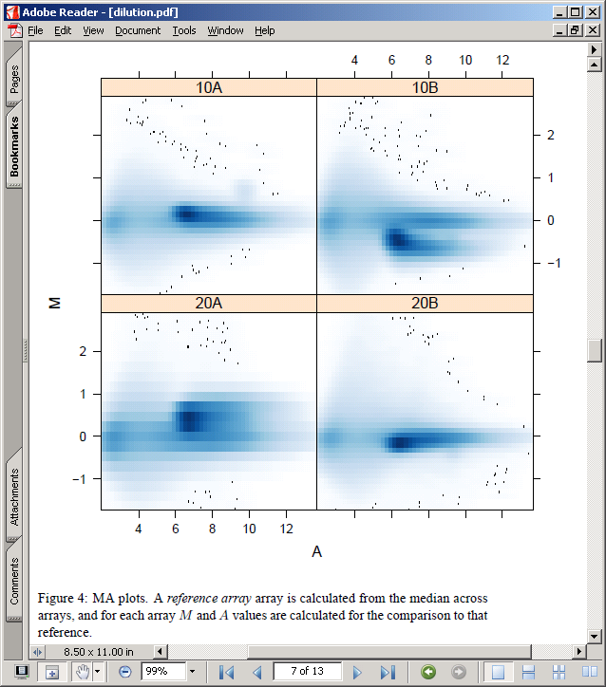
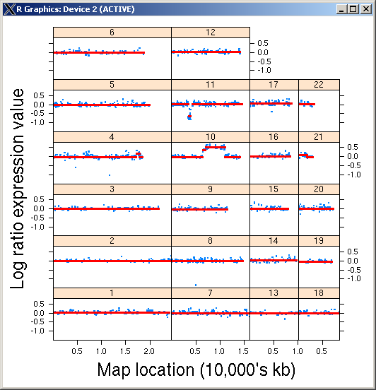
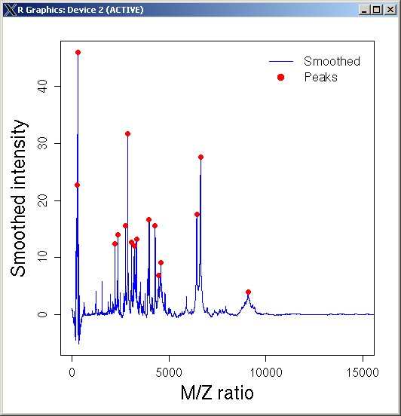
Examples of package functionalities

Slide 14
Lesson 2:
Required Steps for Grid-enabling
Bioconductor packages

Slide 15
Bridging caGrid and Bioconductor
Grid services:
  Act on well-defined objects
  Deploy statically typed functions
Bioconductor / R packages:
  Have objects of formal S4 or informal ‘classes’
  Functions are not strongly typed
Java language has well-established support for Grid services while R currently does not; however there are well-developed tools for interfacing between Java and R
R packages TypeInfo and RWebServices provide functionality for exposing R functions in a Java-based web services context

Slide 16
Steps for Grid-enabling Bioconductor packages
Add TypeInfo to R function arguments and return values
Create Java templates for R objects and functions
Write and run tests for data transfer from R to Java and back
Add Java code to the R package for redistribution

Slide 17
Prerequisites:
Deploying caGrid-enabled packages
Technical aspects
  System architecture
  Configuration and deployment
  (Deploying as web services)
Hardware requirements
  Bioconductor workers: 32- or 64-bit linux-based
Service software
  Tomcat, caGrid
  activeMQ, Bioconductor workers (managed via ant tasks)
caGrid-enabled packages are introduce projects
  Bioconductor and caGrid properties files
    E.g., activeMQ server host and port
  Deploy with introduce ant targets

Slide 18
1. Add TypeInfo to R function arguments and return values
Required R package: TypeInfo
Main functions used:
  typeInfo: provides access to type information for a function.
  SimultaneousTypeSpecification: a constructor function for specifying different permissible combinations of argument types in a call to a function. Each combination of types identifies a signature and in a call, the types of the arguments are compared with these types. If all are compatible with the specification, then the call is valid. Otherwise, we check other permissible combinations.
  TypedSignature: a constructor function for the ‘TypedSignature-class’ that represents constraints on the types or values of a combination of parameters, It takes named arguments that identify the types of parameters. Each parameter type should be an object that is compatible with ‘ClassNameOrExpression-class’, i.e. a test for inheritance or a dynamic expression.

Slide 19
1. Add TypeInfo to R function arguments and return values
Example: myFunction takes a character argument x and an argument y that can either be logical or a character, and then returns a logical value.
typeInfo(myFunction) <-
SimultaneousTypeSpecification(
TypedSignature(x = "character",y = "logical"),
TypedSignature(x = "character",y ="character"),
returnType = "logical")

Slide 20
1. Add TypeInfo to R function arguments and return values
Repeat this for all functions to be exposed
Include TypeInfo in the ‘Depends’ fields of the package DESCRIPTION file
Update help *.Rd files in man directory
Compile and install R package as usual

Slide 21
2. Create Java templates for the R objects and functions
Required R package: RWebServices
Main functions used:
  unpackAntScript: unpacks a ‘master’ script and partly configured properties files to a convenient directory location.
  createMap: extracts type information from R function definitions and uses this to create Java-style function calls with appropriately typed arguments. Types are then converted to Java objects.

Slide 22
2. Create Java templates for the R objects and functions
Apache Ant scripts are XML-based configuration files used by Apache Ant to build Java code, here they are used for:
  Parameter settings
  Producing Java templates
  Compilation
  Documentation
Unpack Ant scripts at with the unpackAntScript command or at the command line with:
  echo "library(RWebServices); unpackAntScript(‘~/temp/<pkg>’)" | R --vanilla
  where ‘~/temp/<pkg>’ is the path to a temporary directory.

Slide 23
3. Write and run tests for data transfer from R to Java and back
Tests must encompass:
  Producing test data and testing data transfer
  Modifying Java templates
  Modifying testing code
  Modifying class initialization values
  Copying required library files
  Running tests
For specific directions see RWebServices package vignette “Enabling R packages for web or grid services”
Also see the lumi use case for an example

Slide 24
4. Add Java code to the R package for redistribution
This optional step is to be completed after R methods have been exposed and working tests are developed
Required Java libraries must be added to the directory ‘<pkg>/inst/rservices/lib’
The following command line will accomplish these additions:
ant map-package unpack-package -Dpkg=<pkg>

Slide 25
Lesson 3:
A Use Case:
Enabling the lumi Package
for Grid Services

Slide 26
Bioconductor lumi package
Provides BeadArray specific methods for Illumina microarrays, including
  Data input
  Quality control
  Variance stabilization
  Normalization
  Gene annotation
  A new variance-stabilizing transformation (VST) algorithm
  A new robust spline normalization (RSN) algorithm
  Options for other popular preprocessing methods
Compatible with other Bioconductor packages

Slide 27
Function to expose
Expose caLumiExpresso function:
caLumiExpresso <- function(measuredBioAssays, lumiExpressoParameter) {
…
}

Slide 28
Adding TypeInfo to caLumiExpresso
typeInfo(caLumiExpresso) <-
SimultaneousTypeSpecification(
TypedSignature(measuredBioAssays = "MeasuredBioAssayMatrix", lumiExpressoParameter = "LumiExpressoParameter"),
TypedSignature(measuredBioAssays = "character", lumiExpressoParameter = "LumiExpressoParameter"),
returnType = "NumericMatrix")

Slide 29
R to Java mapping – RWebServices, SJava
Data and methods
  Argument and return value data beans
  activeMQ server, Bioconductor service and workers
Automatic test framework
Automatic package reuse
  Sample data conversion
  Documentation
Command:
  ant -Dpkg=caLumi map-package
Java source and test code structure:
src/
…/<DataBean>
…/<service>
…/<worker>
test/
…/<DataTest>
…/<ServiceTest>

Slide 30
Modify the testing code and run the tests
Modify the automatically produced a Java test code at:
  test/src/org/bioconductor/rserviceJms/services/caLumiTest.java
Running tests in three terminal windows
  (1) a running activemq
      cd $JMS_HOME
      bin/activemq
  (2) a ‘worker’ to perform calculations
      cd ~/temp/caLumi
      ant precompile start-worker
  (3) the Java program to run the tests.
      cd ~/temp/caLumi
      ant local-test
  Note: “~/temp/caLumi” is where the testing caLumi package is located.

Slide 31
caGrid enabling
caGrid service creation
  Data type description (xsd)
  Semantic annotation – caDSR
  caGrid introduce project creation
‘Wrap’ Bioconductor services as caGrid services
  Argument and return value conversion
  Initialize and invoke service
ant task incorporates Bioconductor jars into introduce

Slide 32
Manuals and References
User’s Guide: http://cabigcvs.nci.nih.gov/viewcvs/viewcvs.cgi/bioconductor/Adopter_Northwestern/Task%202.10.2_Final%20End%20User%20Guide/
Installation Guide: http://cabigcvs.nci.nih.gov/viewcvs/viewcvs.cgi/bioconductor/Developer_FHCC/Task%202.15.2_Installation%20Guide/
Technical Manual: http://cabigcvs.nci.nih.gov/viewcvs/viewcvs.cgi/bioconductor/Developer_FHCC/Task%202.15.1_Technical%20Manual/
Software Requirements and Specification: http://cabigcvs.nci.nih.gov/viewcvs/viewcvs.cgi/bioconductor/Developer_FHCC/Task%202.4.2_Final%20Req%20and%20Spec%20Document/
Bioconductor: http://www.bioconductor.org

Slide 33
Questions?
We would like to hear from you: please send us your questions and/or suggestions.
You can also refer to the user’s guide for more details.

